Slide 1
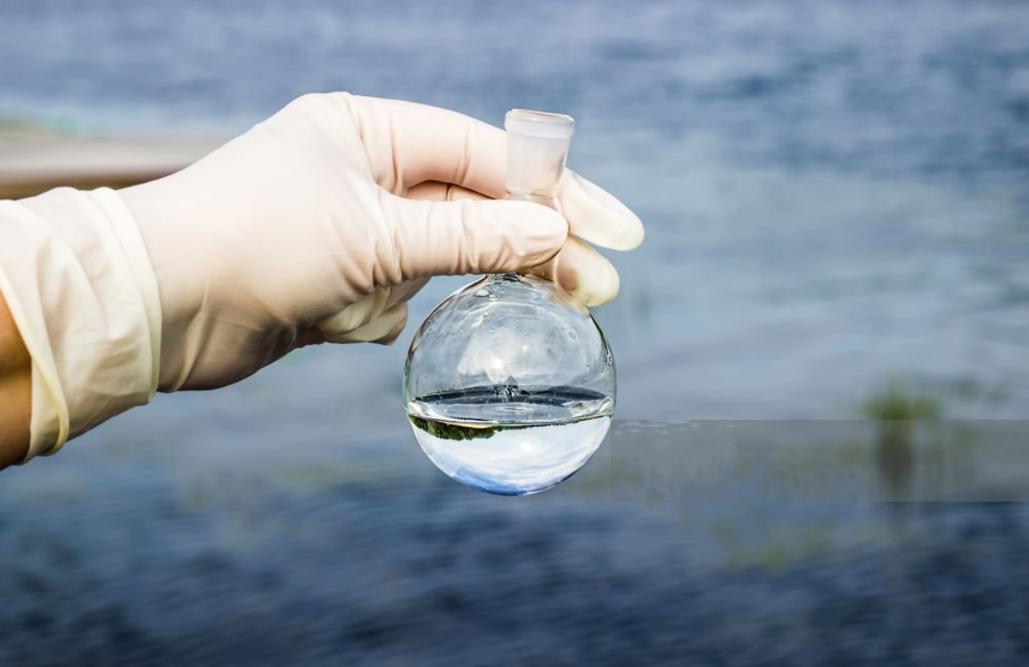
DETECTION OF WATER POTABILITY
NAME :S.GAYATHRI
ROLL NO :2203A52120
SECTION : AIML( A)

Slide 2
INTRODUCTION
Water quality and potability are critical factors that directly impact public health and environmental sustainability. Understanding and ensuring the safety of our water supply is of paramount importance. Machine learning, a branch of artificial intelligence, has emerged as a powerful tool in this domain. It leverages algorithms and statistical models to analyze complex data sets, making it particularly well-suited for addressing challenges related to water quality assessment and potability prediction.
One of the primary applications of machine learning in water quality management is in the prediction of contaminants and pollutants. By training models on historical data encompassing various water quality parameters such as pH levels, turbidity, dissolved oxygen, and concentrations of specific contaminants like heavy metals or pathogens, machine learning algorithms can learn to recognize patterns and correlations. This enables them to forecast potential water quality issues, allowing for timely interventions to prevent contamination.

Slide 3
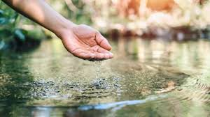
This dataset contains water quality measurements and assessments related to potability, which is the suitability of water for human consumption. The dataset's primary objective is to provide insights into water quality parameters and assist in determining whether the water is potable or not. Each row in the dataset represents a water sample with specific attributes, and the "Potability" column indicates whether the water is suitable for consumption.

Slide 4
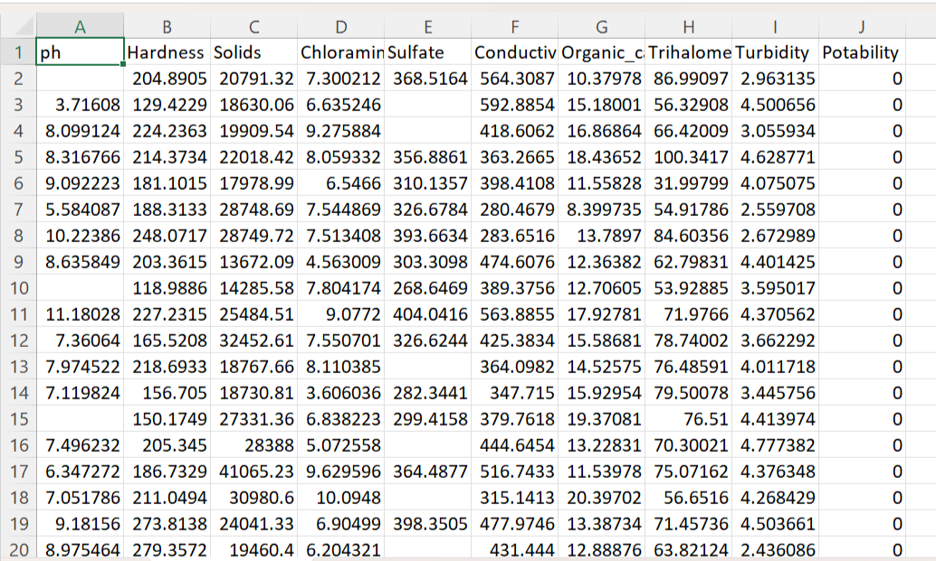
DATA SET:

Slide 5
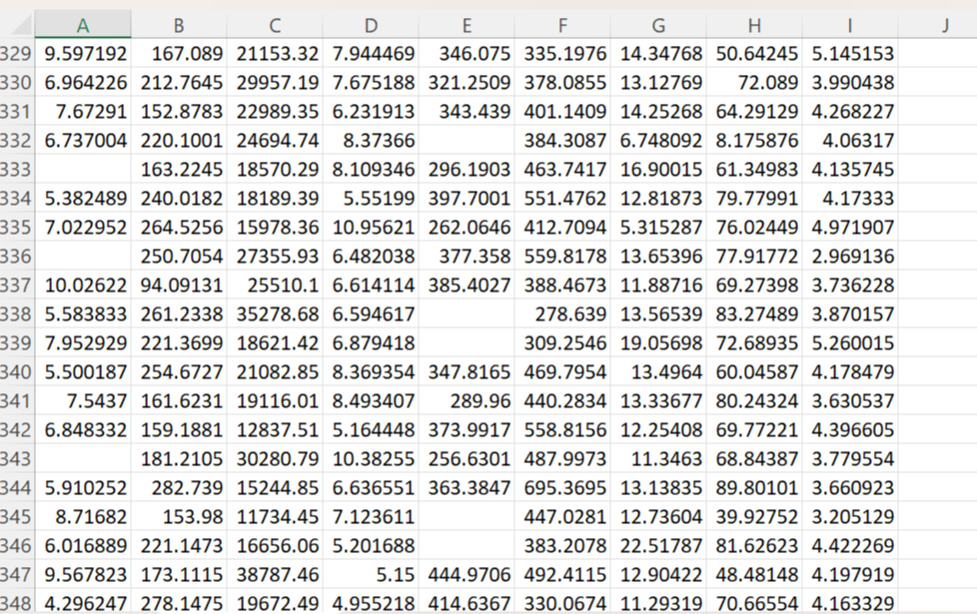

Slide 6
IMPLEMENTATION:
Perceptron:
A perceptron is a fundamental building block of artificial neural networks and serves as a simple model of a biological neuron. It was developed by Frank Rosenblatt in the late 1950s. A perceptron takes a set of binary inputs and produces a binary output based on a weighted sum of these inputs. It can be used for binary classification tasks where it learns to separate data points into two categories.
Here's an explanation of the perceptron with its formula:
Inputs: A perceptron takes multiple binary input values, denoted as x₁, x₂, x₃, ..., xᵢ. These inputs can be either 0 or 1.
Weights: Each input is associated with a weight, denoted as w₁, w₂, w₃, ..., wᵢ. These weights are real numbers and represent the strength of the connection between the input and the perceptron.
Weighted Sum: The weighted sum of the inputs is calculated as follows:
Weighted Sum (Z) = w₁ * x₁ + w₂ * x₂ + w₃ * x₃ + ... + wᵢ * xᵢ
network architectures.

Slide 7
The perceptron learning algorithm is used to adjust the weights (including the bias weight) during training to find values that allow the perceptron to correctly classify training data. However, perceptrons have limitations and can only learn to classify linearly separable data. For more complex tasks, multiple perceptrons are typically combined in layers to form a multi-layer perceptron (MLP), which can handle nonlinear relationships by using different activation functions and more complex network architectures.

Slide 8
LOGISTIC REGRESSION:
Logistic regression is a statistical model used for binary classification tasks, where the goal is to
predict one of two possible outcomes (e.g., 0 or 1, Yes or No, True or False) based on one or more
input features. Unlike linear regression, which predicts a continuous output, logistic regression
predicts the probability of the binary outcome. It uses the logistic function (also called the sigmoid
function) to model this probability. Here's an explanation of logistic regression with its formula:
Formula: The logistic regression model calculates the probability (P) of a binary event (e.g., the
probability of a positive outcome) using the logistic function:
yp=1/1+e^-z​
=>-Y LOG (YP)-(1-Y) LOG (1-YP)

Slide 9

Support Vector Machine Algorithm:
Support Vector Machine or SVM is one of the most popular Supervised Learning algorithms, which is used for Classification as well as Regression problems. However, primarily, it is used for Classification problems in Machine Learning.
The goal of the SVM algorithm is to create the best line or decision boundary that can segregate n-dimensional space into classes so that we can easily put the new data point in the correct category in the future. This best decision boundary is called a hyperplane.

Slide 10

1.Logistic 0.5310173697270472 2.support vector machine 0.511166253101737
RESULT
MODEL ACCURACY

Slide 11
KNN (K – Nearest Neighbour) KNN is a simple yet effective machine learning algorithm used for classification and regression tasks. In KNN, the fundamental idea is to make predictions based on the majority class or the average value of the K nearest data points in the feature space. KNN is intuitive, easy to implement, and does not require model training, making it particularly suitable for small to medium-sized datasets. However, its computational complexity can become an issue for large datasets, and selecting an appropriate K value is crucial for optimal results. For regression tasks, KNN computes the average of the target values of the K nearest neighbors as the prediction. The choice of the value of K is a critical hyperparameter that affects the algorithm's performance, with smaller K values leading to more flexible but noisy predictions. . In summary, KNN is a straightforward yet effective algorithm that plays a valuable role in detection of water potability . Its capacity to swiftly analyze data and make predictions based on neighbor similarities makes it an indispensable tool for initial exploration and model comparison in the quest for more accurate diagnoses.

Slide 12
KNN with boot strap KNN K-Nearest Neighbors (KNN) with Bootstrap is an extension of the traditional KNN algorithm that incorporates the Bootstrap resampling technique. Bootstrap is a statistical method used to estimate the uncertainty associated with a dataset by repeatedly drawing samples with replacement from the original data. When applied to KNN, Bootstrap can enhance the algorithm's robustness and reliability, especially when dealing with noisy or small datasets In KNN with Bootstrap, instead of relying on a single fixed dataset for predictions, multiple bootstrap samples are generated from the original dataset. The KNN algorithm is then applied to each of these resampled datasets independently, resulting in a collection of KNN models. Predictions are made by aggregating the results of these models, typically through majority voting for classification tasks or averaging for regression tasks. This ensemble approach helps reduce the impact of outliers and noise in the data and provides a more stable and accurate prediction. It also allows for the estimation of prediction uncertainty, as one can analyze the variability in predictions across the bootstrapped models. While KNN with Bootstrap can be computationally more intensive due to multiple model training and predictions, it is a valuable technique for improving the robustness of KNN and gaining insights into the reliability of its predictions, making it a useful tool in various machine learning applications. In conclusion, K-Nearest Neighbors (KNN) with Bootstrap offers a powerful and robust extension to the traditional KNN algorithm. By incorporating Bootstrap resampling, this approach enhances the stability and accuracy of predictions, making it particularly beneficial when dealing with noisy or small datasets.

Slide 13
CONCLUSION:
In conclusion, the analysis of the water quality and potability dataset underscores the critical importance of monitoring and maintaining the purity of our water sources. The comprehensive data provided invaluable insights into various parameters, including pH levels, turbidity, chloride content, and microbial presence. These findings serve as a crucial foundation for formulating targeted strategies to ensure safe and potable water for communities. It is evident that periodic assessments and stringent regulatory measures are essential in safeguarding public health. Furthermore, this dataset reinforces the need for proactive measures in preserving natural water reservoirs and investing in advanced treatment technologies. As we move forward, continued research and collaborative efforts among stakeholders will be paramount in sustaining high-quality water sources for generations to come. This dataset serves as a testament to the ongoing commitment to the universal right of access to clean and safe drinking water.

Slide 14
REFERENCES: GUI Machine learning Git hub link: https://github.com/gayathrisss/stmlproject

Slide 15
*_____THANK YOU____*

